Slide 1

COURSE SLIDES
Claude Microsoft 365 Masterclass (C197)
Course Code: C197
Conducted by Tertiary Infotech Academy Pte Ltd · UEN 201200696W
Version v2.0 · 12 August 2026
© 2026 Tertiary Infotech Academy Pte Ltd. All rights reserved. · www.tertiarycourses.com.sg

Slide 2
COURSE ADMINISTRATION
Welcome & Housekeeping
Claude Microsoft 365 Masterclass (C197) · C197
© 2026 Tertiary Infotech Academy Pte Ltd
1

Slide 3
YOUR TRAINER
About the Trainer
ROLE
Principal Trainer, Tertiary Infotech Academy Pte. Ltd.
JL
CERTIFICATION
Industry certified in the subject area of this course.
Jim Gan Chiu Liang (JL)
DELIVERS
Professional short courses for Tertiary Infotech Academy.
Principal Trainer Tertiary Infotech Academy Pte. Ltd.
FOUNDER
Founder and lead instructor at Tertiary Infotech / Tertiary Courses.
Claude Microsoft 365 Masterclass (C197) · C197
© 2026 Tertiary Infotech Academy Pte Ltd
2

Slide 4
ICE-BREAKER
Let's Know Each Other
Your name and organisation / role.
1
Your experience with this subject (if any).
2
What you want to be able to do after this course.
3
Claude Microsoft 365 Masterclass (C197) · C197
© 2026 Tertiary Infotech Academy Pte Ltd
3

Slide 5
HOUSEKEEPING
Ground Rules
Set your mobile phone to silent mode.
Participate actively — no question is too small.
1
2
Mutual respect: agree to disagree.
One conversation at a time.
3
4
Be punctual; return from breaks on time.
Learn by doing — try every hands-on lab.
5
6
Claude Microsoft 365 Masterclass (C197) · C197
© 2026 Tertiary Infotech Academy Pte Ltd
4

Slide 6
COURSE RESOURCES
Your Connected Course Workspace
Visual course deck
Concepts, process maps, prompt anatomy and realistic Office exhibits.
Detailed Learner Guide
Click-level procedures, full prompts, commands, checks and troubleshooting.
1
2
Eleven lab folders
A connected Lumina Living workflow with a README in every activity folder.
Native Office artifacts
Editable Word, Excel and PowerPoint samples plus reusable review templates.
3
4
Portal: https://lms-tms.tertiaryinfotech.com
Claude Microsoft 365 Masterclass (C197) · C197
© 2026 Tertiary Infotech Academy Pte Ltd
5

Slide 7
SCHEDULE
Lesson Plan — One Connected Company Day
Morning
Afternoon
• Morning · 9:30am–1:10pm
– Topic 1: Governed Foundations for Claude and Microsoft 365 (Labs 1–3)
– Topic 2: Company Planning, Reporting and Policy Work (Labs 4–6)
• Afternoon · 2:10pm–6:30pm
– Topic 3: Financial Analysis and Executive Storytelling (Labs 7–8)
– Topic 4: Agentic Coordination with Outlook, Cowork and Claude Code (Labs 9–11)
• Daily timing
– 8 scheduled hours excluding lunch · 7.5 instructional hours · two tea breaks
Claude Microsoft 365 Masterclass (C197) · C197
© 2026 Tertiary Infotech Academy Pte Ltd
6

Slide 8
WHAT YOU'LL ACHIEVE
Learning Outcomes
Choose the right Claude surface
Select the right Claude and Microsoft 365 operating surface for a governed company task.
Connect governed context
Connect approved Microsoft 365 context and map permissions, sources and evidence boundaries.
1
2
Prompt with an audit trail
Direct Claude with an auditable prompt contract and a human approval gate.
Plan marketing
Produce a decision-ready marketing plan in Word from approved company evidence.
3
4
Shape strategy
Develop an aligned strategic plan with choices, initiatives, owners, measures and risks.
Draft sustainability and HR content
Draft a sustainability report section and HR policy using source, legal and management review controls.
5
6
Claude Microsoft 365 Masterclass (C197) · C197
© 2026 Tertiary Infotech Academy Pte Ltd
7

Slide 9
WHAT YOU'LL ACHIEVE
Learning Outcomes (cont.)
Analyse finance in Excel
Build a formula-driven financial analysis and executive dashboard in Excel.
Tell the story in PowerPoint
Create a highly visual strategic and marketing PowerPoint with native Excel charts and evidence traceability.
7
8
Coordinate Outlook safely
Triage Outlook messages and prepare approval-based replies without bypassing the human send gate.
Orchestrate with Claude Cowork
Use Claude Cowork with Microsoft 365 context to coordinate a multi-file planning workflow.
9
10
Automate with Claude Code
Use Claude Code and approved connectors to update Excel, search Outlook and produce a daily management brief.
11
Claude Microsoft 365 Masterclass (C197) · C197
© 2026 Tertiary Infotech Academy Pte Ltd
8

Slide 10
LEARNING APPROACH
How You'll Learn
1
2
3
4
5
▶
▶
▶
▶
Trainer demonstrates the concept
You build it yourself in the hands-on lab
Verify with the lab's 'Test it' step
Discuss and troubleshoot together
Recap against the learning outcomes
Claude Microsoft 365 Masterclass (C197) · C197
© 2026 Tertiary Infotech Academy Pte Ltd
9

Slide 11
CORE CONCEPTS
The Lumina Living Management Challenge
Claude Microsoft 365 Masterclass (C197) · C197
© 2026 Tertiary Infotech Academy Pte Ltd
10

Slide 12
OVERVIEW
One Company, One Connected Evidence Chain
Plan the year — translate the company's growth ambition into marketing priorities, strategic initiatives and governed policies.
Model the economics — test revenue, margin, budget and scenario assumptions in an auditable Excel workbook.
1
2
Communicate the decision — build a company-standard executive deck using verified Word and Excel content.
Coordinate the work — triage Outlook, use Cowork for multi-file execution and use Claude Code for a repeatable daily brief.
3
4
Claude Microsoft 365 Masterclass (C197) · C197
© 2026 Tertiary Infotech Academy Pte Ltd
11

Slide 13
THE BUILDING BLOCKS
The FRAME Control Loop
Frame
Name the decision, audience, permitted sources and definition of done.
Retrieve
Bring only authorised files, messages and ranges into context.
1
2
Act
Ask Claude to draft or edit the smallest useful unit in the native work product.
Measure
Verify figures, claims, formulas, formatting and policy constraints.
3
4
Endorse
Record assumptions and obtain the named human approval before save, send or release.
5
Claude Microsoft 365 Masterclass (C197) · C197
© 2026 Tertiary Infotech Academy Pte Ltd
12

Slide 14
THE PROFESSIONAL STANDARD
From Polished Output to Trusted Work
A polished output is not a trusted output until its evidence, logic and owner are visible.
1
2
3
4
EVIDENCE
LOGIC
OWNERSHIP
HAND-OFF
Claims trace to a file, heading, cell, range or approved message.
Formulas, assumptions and recommendations remain visible and challengeable.
A named reviewer accepts the business decision and unresolved risk.
The presentation teaches the business architecture. The Learner Guide and lab folders contain the exact prompts, commands, source files and review checks.
Claude Microsoft 365 Masterclass (C197) · C197
© 2026 Tertiary Infotech Academy Pte Ltd
13

Slide 15
COURSE ROADMAP
The Company Pack You Will Build
Plans and policies
Analysis and story
Agentic coordination
• Marketing plan
• Strategic plan
• Sustainability and HR drafts
• Financial model
• Executive dashboard
• Strategic and marketing deck
• Outlook draft workflow
• Cowork project
• Claude Code daily brief
Claude Microsoft 365 Masterclass (C197) · C197
© 2026 Tertiary Infotech Academy Pte Ltd
14

Slide 16
THE LEARNING ARC
How Every Activity Connects
Open the lab folder and inspect its realistic Word, Excel and PowerPoint company artifacts.
Use the named evidence and prompt contract to create or improve a work product.
1
2
Challenge the result against formulas, sources, policy boundaries and company templates.
Record the approval, retain the verified artifact and pass only approved context to the next activity.
3
4
Claude Microsoft 365 Masterclass (C197) · C197
© 2026 Tertiary Infotech Academy Pte Ltd
15

Slide 17
PROMPTING FOR OFFICE WORK
Prompts That Produce Reviewable Work
Word · Excel · PowerPoint · evidence · constraints · approval
Claude Microsoft 365 Masterclass (C197) · C197
© 2026 Tertiary Infotech Academy Pte Ltd
16

Slide 18
BUSINESS RESULT TO APPROVAL GATE
The Five-Part Prompt Contract
Name the business result
State the decision, audience and artifact—not merely the app you are using.
Ground the work
Name the open file, table, sheet, section or approved message set Claude may use.
1
2
Constrain the edit
Define scope, length, style, formula method, layout and anything Claude must not change.
Demand evidence
Require cell, range, heading or email citations and ask Claude to flag missing information.
3
4
Set the approval gate
Ask for proposed changes first; verify them before accepting, saving, sending or publishing.
5
Claude Microsoft 365 Masterclass (C197) · C197
© 2026 Tertiary Infotech Academy Pte Ltd
17

Slide 19
GOOD PROMPT EXAMPLE
Word Prompt — Draft a decision-ready strategy section
1
Name the business result
Using the open FY2027 strategy brief, draft only the 'Strategic choices' section for the Executive Committee.
2
Ground the work
Preserve the existing Heading 1/2 styles.
3
Constrain the edit
For each choice include rationale, owner, measure and Q1 milestone.
4
Demand evidence
Use only facts stated in the brief; cite the source heading and flag missing evidence.
5
Set the approval gate
Show proposed text before editing the document.
Copy the complete Word prompt from the Learner Guide or matching lab folder; verify every source and proposed edit.
Claude Microsoft 365 Masterclass (C197) · C197
© 2026 Tertiary Infotech Academy Pte Ltd
18

Slide 20
GOOD PROMPT EXAMPLE
Excel Prompt — Build an auditable financial view
1
Name the business result
Using tblFinance in the open workbook, build a formula-driven Actual vs Budget analysis by month and channel.
2
Ground the work
Include Revenue, Gross Profit, Gross Margin and Operating Contribution.
3
Constrain the edit
Use native formulas or pivots, cite source ranges, keep assumptions on the Assumptions sheet, and do not paste hardcoded totals.
4
Demand evidence
Before editing, list the formulas and checks you will apply.
5
Set the approval gate
Return the proposed change for human verification before editing, saving or releasing the file.
Copy the complete Excel prompt from the Learner Guide or matching lab folder; verify every source and proposed edit.
Claude Microsoft 365 Masterclass (C197) · C197
© 2026 Tertiary Infotech Academy Pte Ltd
19

Slide 21
GOOD PROMPT EXAMPLE
PowerPoint Prompt — Create an executive planning story
1
Name the business result
Using the open company template, the approved strategy document and verified Excel dashboard, build an eight-slide Executive Committee story.
2
Ground the work
Use conclusion-led titles, one message per slide, native editable charts linked to the approved summary ranges, and concise speaker notes.
3
Constrain the edit
Preserve the slide master and brand rules.
4
Demand evidence
Add a source note to each data slide and flag any figure that does not reconcile.
5
Set the approval gate
Return the proposed change for human verification before editing, saving or releasing the file.
Copy the complete PowerPoint prompt from the Learner Guide or matching lab folder; verify every source and proposed edit.
Claude Microsoft 365 Masterclass (C197) · C197
© 2026 Tertiary Infotech Academy Pte Ltd
20

Slide 22
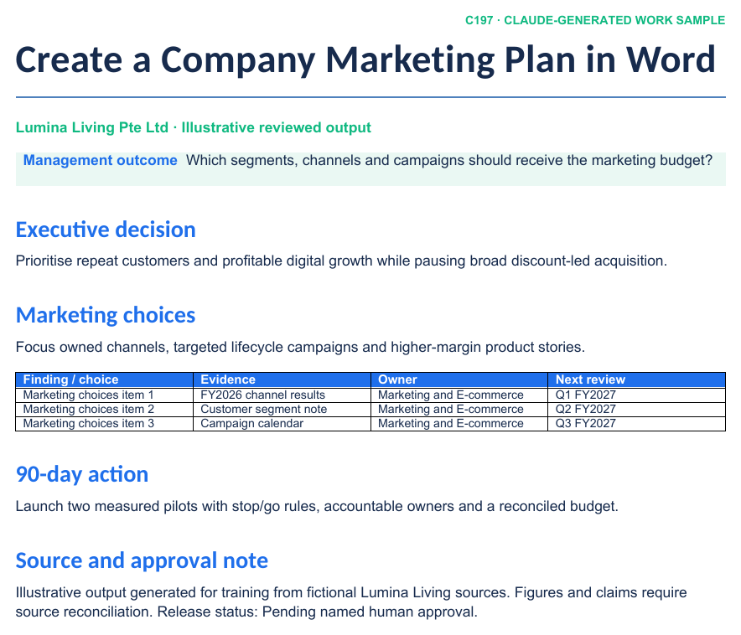
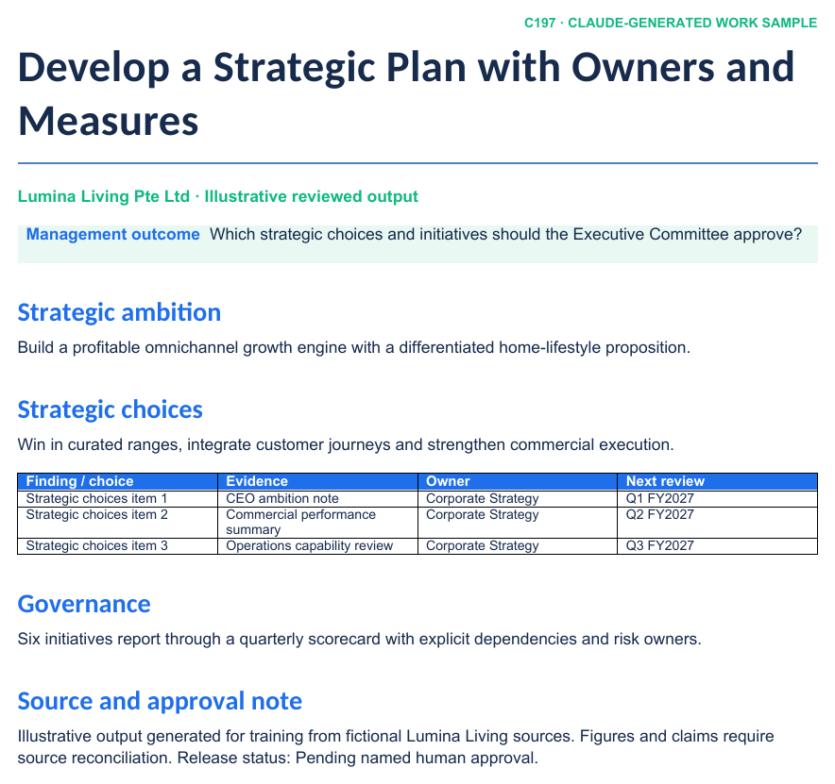
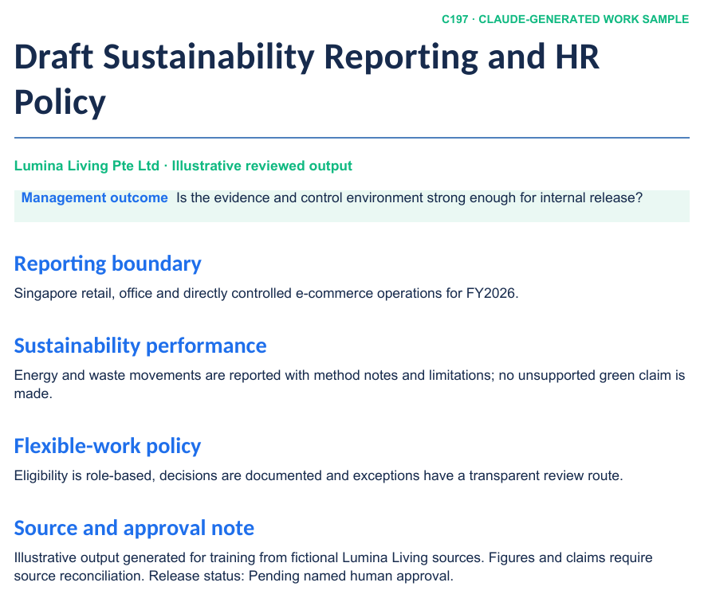
REALISTIC COMPANY WORK
Claude-Generated Planning and Policy Samples
LAB 04
LAB 05
LAB 06
FY2027 Marketing Plan
Three-Year Strategic Plan
Sustainability and HR Drafts
Claude Microsoft 365 Masterclass (C197) · C197
© 2026 Tertiary Infotech Academy Pte Ltd
21

Slide 23
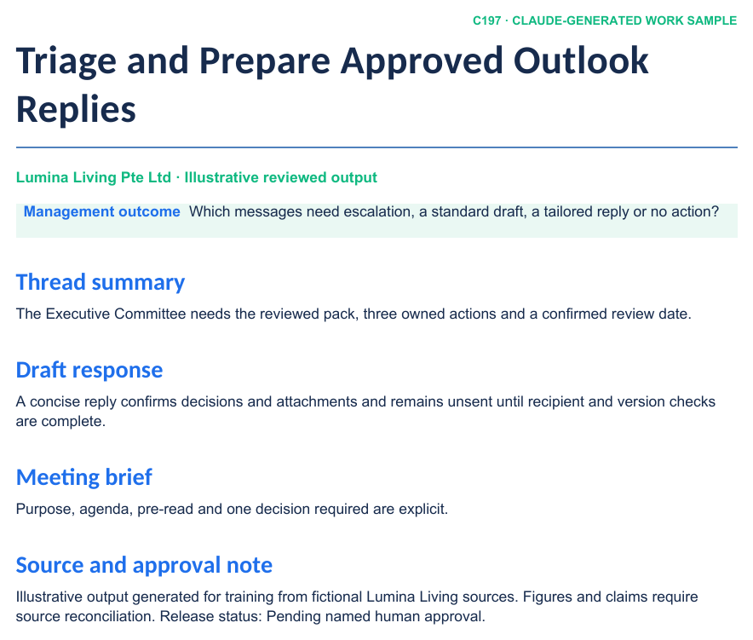
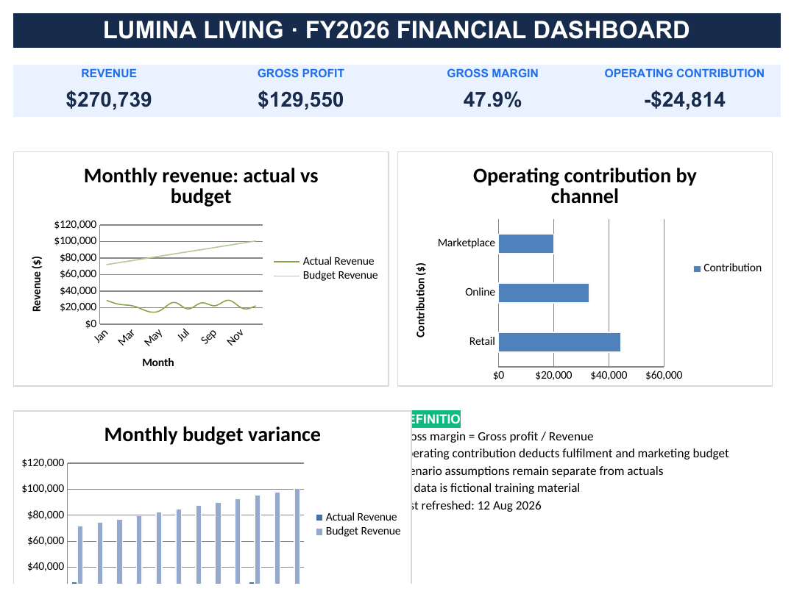
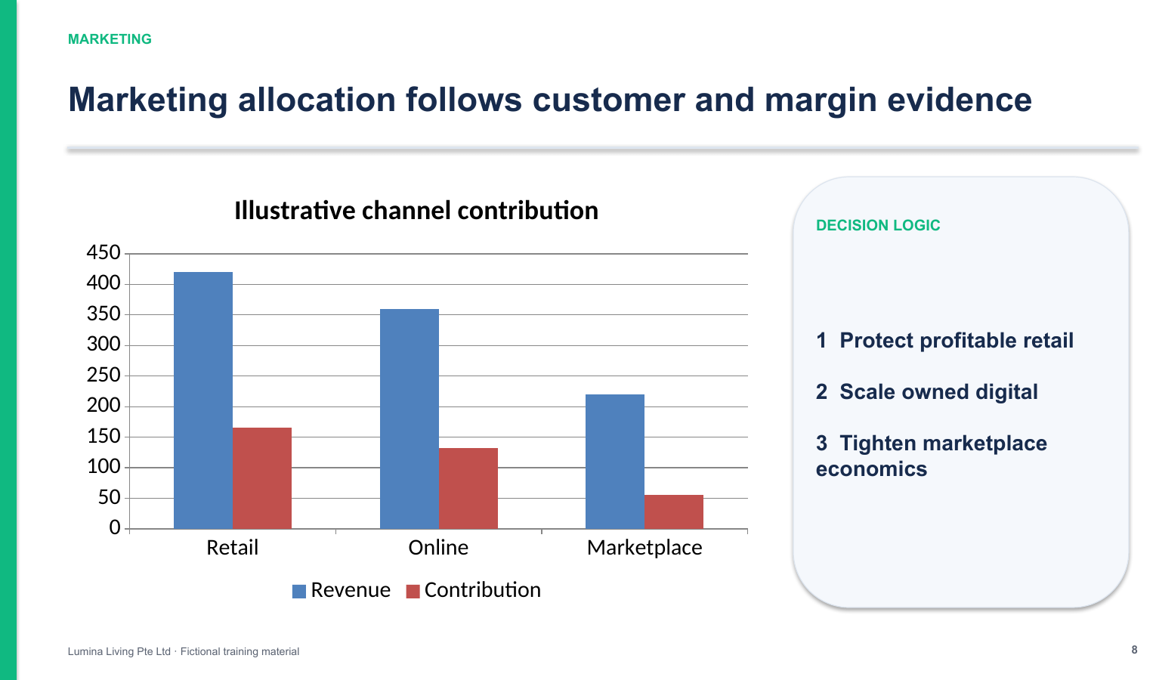
NATIVE OFFICE ARTIFACTS
Claude-Generated Analysis and Executive Samples
LAB 07
LAB 08
LAB 09
Excel Financial Dashboard
Strategy and Marketing PowerPoint
Outlook Thread and Reply Pack
Claude Microsoft 365 Masterclass (C197) · C197
© 2026 Tertiary Infotech Academy Pte Ltd
22

Slide 24
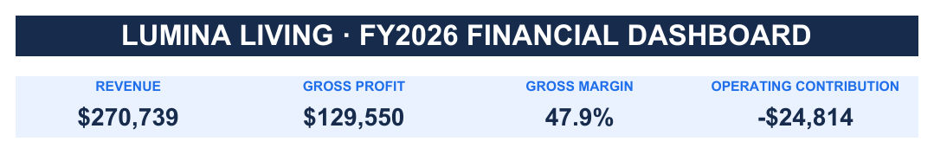
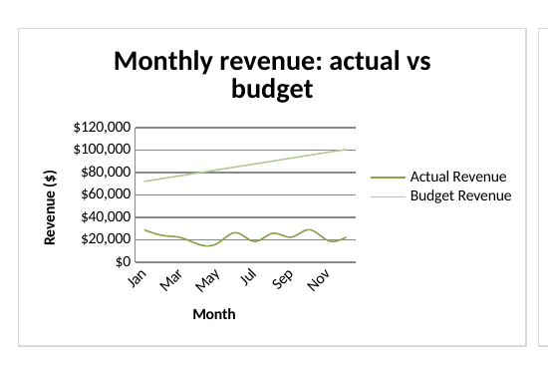
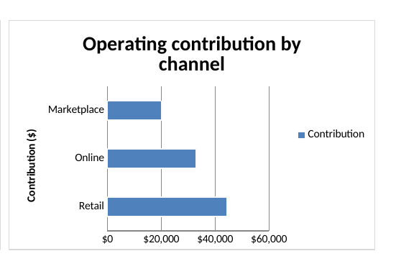
READABLE NATIVE EXCEL CHARTS
Inside the Claude-Generated Excel Dashboard
Actual vs Budget
Contribution by Channel
Tests whether growth is on plan and where monthly variance emerges.
Separates revenue scale from contribution quality for resource decisions.
Claude Microsoft 365 Masterclass (C197) · C197
© 2026 Tertiary Infotech Academy Pte Ltd
23

Slide 25
01
TOPIC 01
Governed Foundations for Claude and Microsoft 365
Operating surfaces · Microsoft 365 connector · permissions · evidence · prompting · human approval
Claude Microsoft 365 Masterclass (C197) · C197
© 2026 Tertiary Infotech Academy Pte Ltd
24

Slide 26
COURSE COVERAGE 24%
Key Concepts — Governed Foundations for Claude and Microsoft 365
Four operating surfaces — distinguish Claude for Microsoft 365 add-ins, the Microsoft 365 connector in Claude, Anthropic Claude Cowork, and Claude-powered experiences inside Microsoft 365 Copilot.
Open-file context — the Word, Excel, PowerPoint and Outlook add-ins work with the active item and preserve native structures such as styles, formulas and slide masters.
1
2
Connected work context — the Microsoft 365 connector can search authorised SharePoint, OneDrive, Outlook and Teams content; optional write tools require additional tenant consent.
Least privilege — access follows the signed-in user's existing permissions; broad access is not a substitute for a well-scoped business task.
3
4
Evidence contract — every material claim names its source location, confidence and unresolved gap before the output is polished.
Human accountability — reviewed changes, formulas, recipients and approval records make AI-assisted work defensible.
5
6
Claude Microsoft 365 Masterclass (C197) · C197
© 2026 Tertiary Infotech Academy Pte Ltd
25

Slide 27
WHAT YOU'LL DO
Hands-On Labs — Governed Foundations for Claude and Microsoft 365
Lab 1
Lab 2
Lab 3
• Choose and Activate the Right Claude Surface — A completed operating-surface decision matrix and environment-readiness record.
• Connect Microsoft 365 Context and Map Permissions — A least-privilege source register with access status, evidence owner, retention note and approved use.
• Build an Auditable Prompt and Review Contract — A reusable cross-app prompt library, prompt test log and acceptance checklist.
Claude Microsoft 365 Masterclass (C197) · C197
© 2026 Tertiary Infotech Academy Pte Ltd
26

Slide 28
TOPIC 01 · HANDS-ON
Choose and Activate the Right Claude Surface
LAB 1
Compare the Office add-ins, Microsoft 365 connector, Claude Cowork and Claude-powered Microsoft 365 Copilot experiences before touching company data.
You'll build
A completed operating-surface decision matrix and environment-readiness record.
Tools: Claude for Microsoft 365, Claude connector, Claude Cowork, Microsoft 365 Copilot, admin deployment
Claude Microsoft 365 Masterclass (C197) · C197
© 2026 Tertiary Infotech Academy Pte Ltd
27

Slide 29
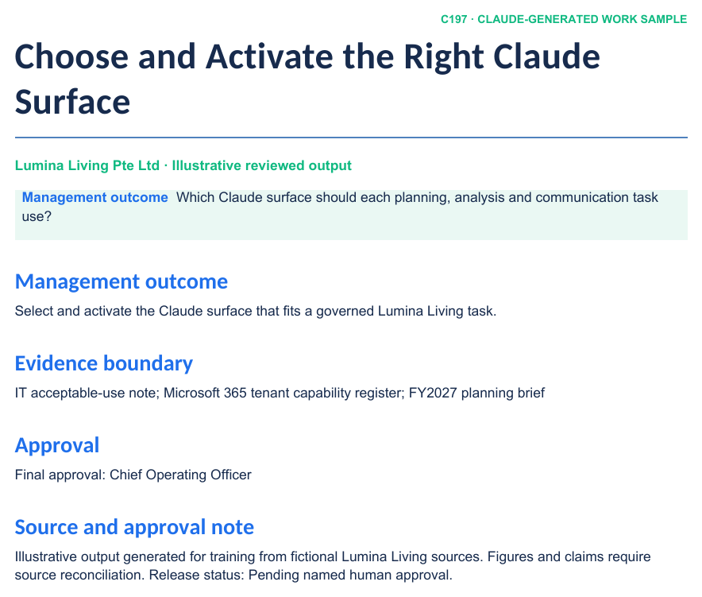
LAB 1 · SCREENSHOT
Claude-Generated Company Work Sample
WHAT TO NOTICE
1
Business outcome
The opening section states the management decision and intended use.
2
Evidence structure
Headings, tables and source notes make claims reviewable in native Word.
3
Approval boundary
The status and named reviewer remain visible before release or send.
A rendered preview of the realistic Word, Excel or PowerPoint artifact supplied in this lab folder.
Claude Microsoft 365 Masterclass (C197) · C197
© 2026 Tertiary Infotech Academy Pte Ltd
28

Slide 30
CONCEPT-TO-OUTCOME
Lab 1 — Process Map
1
2
3
4
5
▶
▶
▶
▶
Define the task
Compare surfaces
Check licence and tenant
Activate the approved route
Record the fallback
Claude Microsoft 365 Masterclass (C197) · C197
© 2026 Tertiary Infotech Academy Pte Ltd
29

Slide 31
KEY DECISIONS & CONTROLS
Lab 1 — Professional Practice
Office add-ins
Best for editing the open Word, Excel, PowerPoint or Outlook item in its native structure.
M365 connector
Best for searching approved SharePoint, OneDrive, Outlook and Teams context from Claude.
1
2
Claude Cowork
Best for a bounded multi-step task across a folder, Project and connected tools.
Copilot experiences
A separate Microsoft-managed surface whose availability and governance depend on the tenant.
3
4
Claude Microsoft 365 Masterclass (C197) · C197
© 2026 Tertiary Infotech Academy Pte Ltd
30

Slide 32
LAB 1 · VERIFY
Choose and Activate the Right Claude Surface
✅ ACCEPTANCE CHECK
Every example task has one preferred surface, one governed fallback, a permission owner and a human approval point; no credential is stored in any learner-facing file.
INSPECT
RECONCILE
ENDORSE
Open the native artifact and challenge its sources, formulas, structure and versions.
Confirm every material figure or claim against the approved evidence location.
Record the named reviewer before accepting, saving, releasing or sending the work.
Claude Microsoft 365 Masterclass (C197) · C197
© 2026 Tertiary Infotech Academy Pte Ltd
31

Slide 33
TOPIC 01 · HANDS-ON
Connect Microsoft 365 Context and Map Permissions
LAB 2
Build a source-and-permission register for Lumina Living's SharePoint, OneDrive, Outlook and Teams planning evidence.
You'll build
A least-privilege source register with access status, evidence owner, retention note and approved use.
Tools: Microsoft 365 connector, Microsoft Entra, delegated permissions, SharePoint, OneDrive, Outlook, Teams
Claude Microsoft 365 Masterclass (C197) · C197
© 2026 Tertiary Infotech Academy Pte Ltd
32

Slide 34
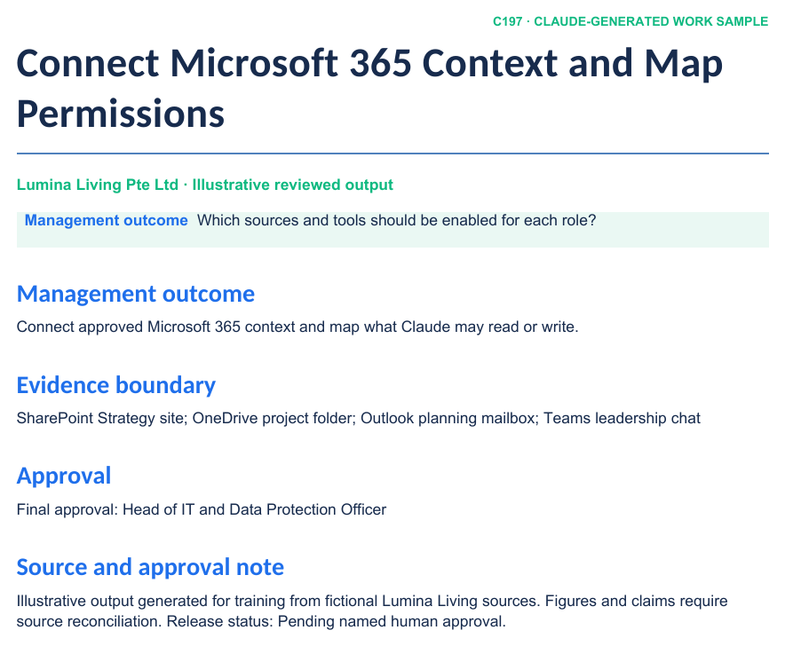
LAB 2 · SCREENSHOT
Claude-Generated Company Work Sample
WHAT TO NOTICE
1
Business outcome
The opening section states the management decision and intended use.
2
Evidence structure
Headings, tables and source notes make claims reviewable in native Word.
3
Approval boundary
The status and named reviewer remain visible before release or send.
A rendered preview of the realistic Word, Excel or PowerPoint artifact supplied in this lab folder.
Claude Microsoft 365 Masterclass (C197) · C197
© 2026 Tertiary Infotech Academy Pte Ltd
33

Slide 35
CONCEPT-TO-OUTCOME
Lab 2 — Process Map
1
2
3
4
5
▶
▶
▶
▶
Inventory sources
Assign owners
Grant tenant consent
Connect individually
Test read before write
Claude Microsoft 365 Masterclass (C197) · C197
© 2026 Tertiary Infotech Academy Pte Ltd
34

Slide 36
KEY DECISIONS & CONTROLS
Lab 2 — Professional Practice
Delegated access
Claude acts through the signed-in user and cannot exceed that user's Microsoft 365 permissions.
Read-first rollout
Search and summarise approved context before enabling any create, update or send capability.
1
2
Two consent layers
Organisation enablement and Microsoft Entra administrator consent precede individual connection.
Write-tool boundary
Email, calendar and file writes need additional scopes, policy approval and stronger review.
3
4
Claude Microsoft 365 Masterclass (C197) · C197
© 2026 Tertiary Infotech Academy Pte Ltd
35

Slide 37
LAB 2 · VERIFY
Connect Microsoft 365 Context and Map Permissions
✅ ACCEPTANCE CHECK
The source register reconciles to the connector results, every source has an owner and approved use, and write tools are either explicitly authorised or documented as unavailable.
INSPECT
RECONCILE
ENDORSE
Open the native artifact and challenge its sources, formulas, structure and versions.
Confirm every material figure or claim against the approved evidence location.
Record the named reviewer before accepting, saving, releasing or sending the work.
Claude Microsoft 365 Masterclass (C197) · C197
© 2026 Tertiary Infotech Academy Pte Ltd
36

Slide 38
TOPIC 01 · HANDS-ON
Build an Auditable Prompt and Review Contract
LAB 3
Turn vague requests into professional prompt contracts for Word, Excel and PowerPoint, then log evidence and review outcomes.
You'll build
A reusable cross-app prompt library, prompt test log and acceptance checklist.
Tools: Prompt architecture, evidence clauses, stop rules, output contracts, review log
Claude Microsoft 365 Masterclass (C197) · C197
© 2026 Tertiary Infotech Academy Pte Ltd
37

Slide 39
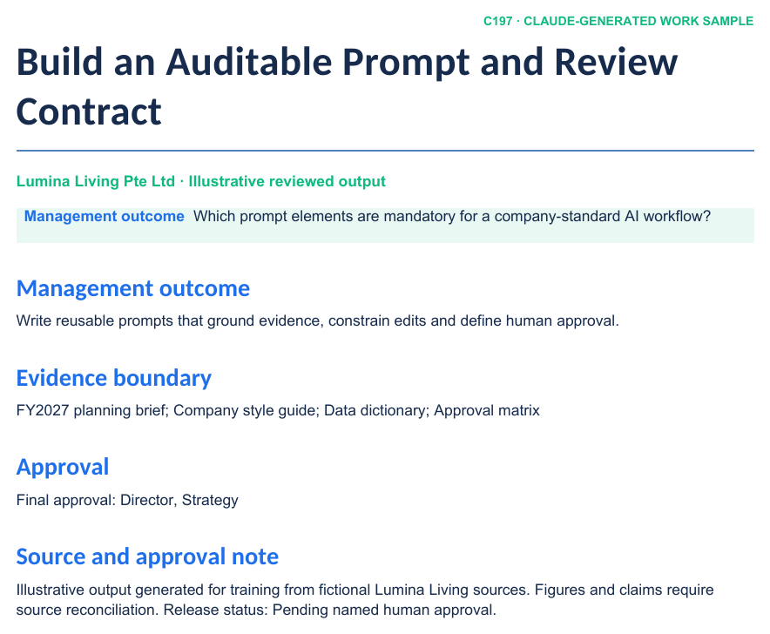
LAB 3 · SCREENSHOT
Claude-Generated Company Work Sample
WHAT TO NOTICE
1
Business outcome
The opening section states the management decision and intended use.
2
Evidence structure
Headings, tables and source notes make claims reviewable in native Word.
3
Approval boundary
The status and named reviewer remain visible before release or send.
A rendered preview of the realistic Word, Excel or PowerPoint artifact supplied in this lab folder.
Claude Microsoft 365 Masterclass (C197) · C197
© 2026 Tertiary Infotech Academy Pte Ltd
38

Slide 40
CONCEPT-TO-OUTCOME
Lab 3 — Process Map
1
2
3
4
5
▶
▶
▶
▶
Business outcome
Named evidence
Constraints
Output contract
Verification and approval
Claude Microsoft 365 Masterclass (C197) · C197
© 2026 Tertiary Infotech Academy Pte Ltd
39

Slide 41
KEY DECISIONS & CONTROLS
Lab 3 — Professional Practice
Outcome
Name the decision, audience and work product instead of asking for generic help.
Evidence
Name the open file, table, range, section or messages and require citations.
1
2
Constraints
Specify what must be preserved, excluded, limited or escalated.
Approval
Ask for a proposal first and keep final acceptance, save and send with the authorised user.
3
4
Claude Microsoft 365 Masterclass (C197) · C197
© 2026 Tertiary Infotech Academy Pte Ltd
40

Slide 42
LAB 3 · VERIFY
Build an Auditable Prompt and Review Contract
✅ ACCEPTANCE CHECK
The Word, Excel and PowerPoint prompts each name a business result, approved evidence, constraints, output format, verification method, stop rule and human approval gate.
INSPECT
RECONCILE
ENDORSE
Open the native artifact and challenge its sources, formulas, structure and versions.
Confirm every material figure or claim against the approved evidence location.
Record the named reviewer before accepting, saving, releasing or sending the work.
Claude Microsoft 365 Masterclass (C197) · C197
© 2026 Tertiary Infotech Academy Pte Ltd
41

Slide 43
TOPIC RECAP
Recap — Governed Foundations for Claude and Microsoft 365
Capability — Select and activate the Claude surface that fits a governed Lumina Living task.
Evidence retained — A completed operating-surface decision matrix and environment-readiness record.
1
2
Capability — Connect approved Microsoft 365 context and map what Claude may read or write.
Evidence retained — A least-privilege source register with access status, evidence owner, retention note and approved use.
3
4
Capability — Write reusable prompts that ground evidence, constrain edits and define human approval.
Evidence retained — A reusable cross-app prompt library, prompt test log and acceptance checklist.
5
6
Claude Microsoft 365 Masterclass (C197) · C197
© 2026 Tertiary Infotech Academy Pte Ltd
42

Slide 44
02
TOPIC 02
Company Planning, Reporting and Policy Work
Marketing planning · strategic planning · sustainability reporting · HR policy · management review
Claude Microsoft 365 Masterclass (C197) · C197
© 2026 Tertiary Infotech Academy Pte Ltd
43

Slide 45
COURSE COVERAGE 28%
Key Concepts — Company Planning, Reporting and Policy Work
Marketing planning — connect business goals, customer segments, channel choices, campaign actions, budget and measurable outcomes.
Strategic planning — turn evidence into explicit choices, initiatives, owners, dependencies, targets and review dates.
1
2
Sustainability reporting — define the reporting boundary, method, source owner and limitation before drafting a credible narrative.
HR policy — separate policy intent, operational procedure and legal interpretation; require authorised HR and legal review before release.
3
4
Template fidelity — work inside approved Word styles and tables so outputs fit the company's document system rather than becoming detached chat text.
Management review — label facts, calculations, assumptions and recommendations so decision makers can challenge each layer.
5
6
Claude Microsoft 365 Masterclass (C197) · C197
© 2026 Tertiary Infotech Academy Pte Ltd
44

Slide 46
WHAT YOU'LL DO
Hands-On Labs — Company Planning, Reporting and Policy Work
Lab 4
Lab 5
Lab 6
• Create a Company Marketing Plan in Word — A reviewed FY2027 marketing plan in Word with an evidence appendix and management decision page.
• Develop a Strategic Plan with Owners and Measures — A three-year strategic plan, initiative portfolio and quarterly review scorecard in Word and Excel.
• Draft Sustainability Reporting and HR Policy — A sustainability performance section, metric register and flexible-work policy draft with review and approval records.
Claude Microsoft 365 Masterclass (C197) · C197
© 2026 Tertiary Infotech Academy Pte Ltd
45

Slide 47
TOPIC 02 · HANDS-ON
Create a Company Marketing Plan in Word
LAB 4
Turn an approved commercial brief, customer evidence and budget envelope into a structured marketing plan with objectives, segments, channels, actions, KPIs and approvals.
You'll build
A reviewed FY2027 marketing plan in Word with an evidence appendix and management decision page.
Tools: Claude for Word, company styles, selected-text editing, comments, tracked changes, evidence register
Claude Microsoft 365 Masterclass (C197) · C197
© 2026 Tertiary Infotech Academy Pte Ltd
46

Slide 48
LAB 4 · SCREENSHOT
Claude-Generated Company Work Sample
WHAT TO NOTICE
1
Business outcome
The opening section states the management decision and intended use.
2
Evidence structure
Headings, tables and source notes make claims reviewable in native Word.
3
Approval boundary
The status and named reviewer remain visible before release or send.
A rendered preview of the realistic Word, Excel or PowerPoint artifact supplied in this lab folder.
Claude Microsoft 365 Masterclass (C197) · C197
© 2026 Tertiary Infotech Academy Pte Ltd
47

Slide 49
CONCEPT-TO-OUTCOME
Lab 4 — Process Map
1
2
3
4
5
▶
▶
▶
▶
Commercial objective
Customer evidence
Channel choices
Campaign plan
Measures and approval
Claude Microsoft 365 Masterclass (C197) · C197
© 2026 Tertiary Infotech Academy Pte Ltd
48

Slide 50
KEY DECISIONS & CONTROLS
Lab 4 — Professional Practice
Choice, not a list
Prioritise segments and channels; explain what the company will not fund.
Budget connects to action
Every major campaign has an owner, cost, measure and review date.
1
2
Evidence stays visible
Cite the customer or financial source behind each material recommendation.
Native Word structure
Preserve approved headings, tables, numbering, comments and change tracking.
3
4
Claude Microsoft 365 Masterclass (C197) · C197
© 2026 Tertiary Infotech Academy Pte Ltd
49

Slide 51
LAB 4 · VERIFY
Create a Company Marketing Plan in Word
✅ ACCEPTANCE CHECK
The Word plan uses company styles, reconciles to the marketing budget, contains three clear choices and one non-priority, and every material claim has a source or missing-evidence flag.
INSPECT
RECONCILE
ENDORSE
Open the native artifact and challenge its sources, formulas, structure and versions.
Confirm every material figure or claim against the approved evidence location.
Record the named reviewer before accepting, saving, releasing or sending the work.
Claude Microsoft 365 Masterclass (C197) · C197
© 2026 Tertiary Infotech Academy Pte Ltd
50

Slide 52
TOPIC 02 · HANDS-ON
Develop a Strategic Plan with Owners and Measures
LAB 5
Translate Lumina Living's ambition into a strategy-on-a-page, initiative portfolio and governance rhythm that management can execute.
You'll build
A three-year strategic plan, initiative portfolio and quarterly review scorecard in Word and Excel.
Tools: Claude for Word, Claude for Excel, strategy-on-a-page, initiative portfolio, risk and dependency review
Claude Microsoft 365 Masterclass (C197) · C197
© 2026 Tertiary Infotech Academy Pte Ltd
51

Slide 53
LAB 5 · SCREENSHOT
Claude-Generated Company Work Sample
WHAT TO NOTICE
1
Business outcome
The opening section states the management decision and intended use.
2
Evidence structure
Headings, tables and source notes make claims reviewable in native Word.
3
Approval boundary
The status and named reviewer remain visible before release or send.
A rendered preview of the realistic Word, Excel or PowerPoint artifact supplied in this lab folder.
Claude Microsoft 365 Masterclass (C197) · C197
© 2026 Tertiary Infotech Academy Pte Ltd
52

Slide 54
CONCEPT-TO-OUTCOME
Lab 5 — Process Map
1
2
3
4
5
▶
▶
▶
▶
Ambition
Diagnosis
Strategic choices
Initiative portfolio
Measures and governance
Claude Microsoft 365 Masterclass (C197) · C197
© 2026 Tertiary Infotech Academy Pte Ltd
53

Slide 55
KEY DECISIONS & CONTROLS
Lab 5 — Professional Practice
Choice architecture
A strategy selects where to play, how to win and what not to do.
Initiatives have owners
Each priority carries an accountable executive, milestones, measures and dependencies.
1
2
Measures balance outcomes
Combine financial, customer, operational and capability indicators.
Review drives action
A quarterly cadence tests assumptions and reallocates resources when evidence changes.
3
4
Claude Microsoft 365 Masterclass (C197) · C197
© 2026 Tertiary Infotech Academy Pte Ltd
54

Slide 56
LAB 5 · VERIFY
Develop a Strategic Plan with Owners and Measures
✅ ACCEPTANCE CHECK
The strategy contains explicit choices and trade-offs, six owned initiatives, balanced measures with sources, a governance cadence and a resolved high-impact risk review.
INSPECT
RECONCILE
ENDORSE
Open the native artifact and challenge its sources, formulas, structure and versions.
Confirm every material figure or claim against the approved evidence location.
Record the named reviewer before accepting, saving, releasing or sending the work.
Claude Microsoft 365 Masterclass (C197) · C197
© 2026 Tertiary Infotech Academy Pte Ltd
55

Slide 57
TOPIC 02 · HANDS-ON
Draft Sustainability Reporting and HR Policy
LAB 6
Create a management sustainability report section and a flexible-work HR policy while separating evidence, interpretation, procedure and legal review.
You'll build
A sustainability performance section, metric register and flexible-work policy draft with review and approval records.
Tools: Claude for Word, reporting boundary, metric methodology, HR policy drafting, comments, approval workflow
Claude Microsoft 365 Masterclass (C197) · C197
© 2026 Tertiary Infotech Academy Pte Ltd
56

Slide 58
LAB 6 · SCREENSHOT
Claude-Generated Company Work Sample
WHAT TO NOTICE
1
Business outcome
The opening section states the management decision and intended use.
2
Evidence structure
Headings, tables and source notes make claims reviewable in native Word.
3
Approval boundary
The status and named reviewer remain visible before release or send.
A rendered preview of the realistic Word, Excel or PowerPoint artifact supplied in this lab folder.
Claude Microsoft 365 Masterclass (C197) · C197
© 2026 Tertiary Infotech Academy Pte Ltd
57

Slide 59
CONCEPT-TO-OUTCOME
Lab 6 — Process Map
1
2
3
4
5
▶
▶
▶
▶
Define boundary
Verify metrics
Draft narrative
Separate policy from procedure
Obtain specialist approval
Claude Microsoft 365 Masterclass (C197) · C197
© 2026 Tertiary Infotech Academy Pte Ltd
58

Slide 60
KEY DECISIONS & CONTROLS
Lab 6 — Professional Practice
Boundary before narrative
State entities, sites, period, method and exclusions before describing performance.
Numbers need lineage
Every metric names the source system, owner, unit, method and limitation.
1
2
Policy is not legal advice
AI drafts require authorised HR and legal review before organisational release.
Exceptions are designed
Eligibility, decision rights, escalation and record keeping prevent an attractive policy from becoming unusable.
3
4
Claude Microsoft 365 Masterclass (C197) · C197
© 2026 Tertiary Infotech Academy Pte Ltd
59

Slide 61
LAB 6 · VERIFY
Draft Sustainability Reporting and HR Policy
✅ ACCEPTANCE CHECK
The sustainability section states its boundary and limitations and reconciles every metric; the HR policy separates policy from procedure and carries named HR, legal, security and management reviews.
INSPECT
RECONCILE
ENDORSE
Open the native artifact and challenge its sources, formulas, structure and versions.
Confirm every material figure or claim against the approved evidence location.
Record the named reviewer before accepting, saving, releasing or sending the work.
Claude Microsoft 365 Masterclass (C197) · C197
© 2026 Tertiary Infotech Academy Pte Ltd
60

Slide 62
TOPIC RECAP
Recap — Company Planning, Reporting and Policy Work
Capability — Produce a decision-ready FY2027 marketing plan in the Lumina Living Word template.
Evidence retained — A reviewed FY2027 marketing plan in Word with an evidence appendix and management decision page.
1
2
Capability — Develop an aligned strategic plan with explicit choices, initiatives, owners, measures and risks.
Evidence retained — A three-year strategic plan, initiative portfolio and quarterly review scorecard in Word and Excel.
3
4
Capability — Draft source-aware sustainability reporting and an HR policy with appropriate review controls.
Evidence retained — A sustainability performance section, metric register and flexible-work policy draft with review and approval records.
5
6
Claude Microsoft 365 Masterclass (C197) · C197
© 2026 Tertiary Infotech Academy Pte Ltd
61

Slide 63
03
TOPIC 03
Financial Analysis and Executive Storytelling
Excel modelling · controls · KPI dashboard · native charts · strategic and marketing PowerPoint
Claude Microsoft 365 Masterclass (C197) · C197
© 2026 Tertiary Infotech Academy Pte Ltd
62

Slide 64
COURSE COVERAGE 25%
Key Concepts — Financial Analysis and Executive Storytelling
Financial model architecture — separate assumptions, transaction data, calculations, outputs and review notes so changes remain traceable.
Formula-first analysis — use dynamic formulas, tables and pivot-ready structures instead of pasted totals or unexplained AI answers.
1
2
Decision-led dashboard — combine a small set of KPIs, trends, variances and definitions around the questions management must answer.
Chart integrity — choose the visual for the question, keep native Excel sources, verify scale and units, and avoid implying causation without evidence.
3
4
Message-first presentation — every slide title states a conclusion; supporting detail goes into speaker notes, appendix or source register.
Beyond one-click slides — professional value comes from an editable company template, native charts, coherent narrative, source traceability and deliberate visual hierarchy.
5
6
Claude Microsoft 365 Masterclass (C197) · C197
© 2026 Tertiary Infotech Academy Pte Ltd
63

Slide 65
WHAT YOU'LL DO
Hands-On Labs — Financial Analysis and Executive Storytelling
Lab 7
Lab 8
• Build Financial Analysis and an Excel Dashboard — A controlled FY2026 financial workbook with actual-vs-budget analysis, scenarios, three native charts and an executive dashboard.
• Create an Executive Strategy and Marketing Deck — A ten-slide strategic and marketing presentation with native Excel charts, varied layouts and an executive decision page.
Claude Microsoft 365 Masterclass (C197) · C197
© 2026 Tertiary Infotech Academy Pte Ltd
64

Slide 66
TOPIC 03 · HANDS-ON
Build Financial Analysis and an Excel Dashboard
LAB 7
Move from transaction data and budget assumptions to formula-driven analysis, scenario testing, native charts and a one-screen management dashboard.
You'll build
A controlled FY2026 financial workbook with actual-vs-budget analysis, scenarios, three native charts and an executive dashboard.
Tools: Claude for Excel, tables, formulas, pivots, scenarios, chart selection, dashboard, audit log
Claude Microsoft 365 Masterclass (C197) · C197
© 2026 Tertiary Infotech Academy Pte Ltd
65

Slide 67
LAB 7 · SCREENSHOT
Claude-Generated Company Work Sample
A rendered preview of the realistic Word, Excel or PowerPoint artifact supplied in this lab folder.
Claude Microsoft 365 Masterclass (C197) · C197
© 2026 Tertiary Infotech Academy Pte Ltd
66

Slide 68
CONCEPT-TO-OUTCOME
Lab 7 — Process Map
1
2
3
4
5
▶
▶
▶
▶
Understand the model
Validate inputs
Build formulas
Explain drivers
Dashboard and senior review
Claude Microsoft 365 Masterclass (C197) · C197
© 2026 Tertiary Infotech Academy Pte Ltd
67

Slide 69
KEY DECISIONS & CONTROLS
Lab 7 — Professional Practice
Model architecture
Separate Assumptions, Transactions, Budget, Analysis, Dashboard and Audit Log.
No pasted answers
Keep calculations live in formulas or pivots and cite the source range.
1
2
Charts answer decisions
Use trend, variance and driver visuals with honest scales and units.
Review like a finance leader
Challenge timing, hardcodes, range gaps, margin logic and scenario sensitivity.
3
4
Claude Microsoft 365 Masterclass (C197) · C197
© 2026 Tertiary Infotech Academy Pte Ltd
68

Slide 70
LAB 7 · VERIFY
Build Financial Analysis and an Excel Dashboard
✅ ACCEPTANCE CHECK
The model has no formula errors, all four KPIs reconcile, scenarios change through named assumptions, three native charts answer management questions and the audit log records independent checks.
INSPECT
RECONCILE
ENDORSE
Open the native artifact and challenge its sources, formulas, structure and versions.
Confirm every material figure or claim against the approved evidence location.
Record the named reviewer before accepting, saving, releasing or sending the work.
Claude Microsoft 365 Masterclass (C197) · C197
© 2026 Tertiary Infotech Academy Pte Ltd
69

Slide 71
TOPIC 03 · HANDS-ON
Create an Executive Strategy and Marketing Deck
LAB 8
Build a company-standard Executive Committee presentation with a coherent decision story, native charts, process maps, evidence notes and meaningful speaker notes.
You'll build
A ten-slide strategic and marketing presentation with native Excel charts, varied layouts and an executive decision page.
Tools: Claude for PowerPoint, slide master, native Excel charts, process maps, executive narrative, speaker notes, visual QA
Claude Microsoft 365 Masterclass (C197) · C197
© 2026 Tertiary Infotech Academy Pte Ltd
70

Slide 72
LAB 8 · SCREENSHOT
Claude-Generated Company Work Sample
A rendered preview of the realistic Word, Excel or PowerPoint artifact supplied in this lab folder.
Claude Microsoft 365 Masterclass (C197) · C197
© 2026 Tertiary Infotech Academy Pte Ltd
71

Slide 73
CONCEPT-TO-OUTCOME
Lab 8 — Process Map
1
2
3
4
5
▶
▶
▶
▶
Decision question
Message map
Template system
Native evidence visuals
Executive rehearsal and approval
Claude Microsoft 365 Masterclass (C197) · C197
© 2026 Tertiary Infotech Academy Pte Ltd
72

Slide 74
KEY DECISIONS & CONTROLS
Lab 8 — Professional Practice
Better than one-click
Use real company evidence, deliberate hierarchy and an editable template—not generic generated decoration.
Conclusion-led titles
Every title states the point management should understand or decide.
1
2
Native evidence
Excel charts remain editable and trace to approved ranges; source notes sit on data slides.
Visual rhythm
Alternate scorecards, charts, comparisons, process maps and decision cards without lowering readability.
3
4
Claude Microsoft 365 Masterclass (C197) · C197
© 2026 Tertiary Infotech Academy Pte Ltd
73

Slide 75
LAB 8 · VERIFY
Create an Executive Strategy and Marketing Deck
✅ ACCEPTANCE CHECK
The ten-slide deck uses the company master, shows verified native Excel charts, contains varied substantive visuals and speaker notes, and reconciles every figure and decision with the approved source pack.
INSPECT
RECONCILE
ENDORSE
Open the native artifact and challenge its sources, formulas, structure and versions.
Confirm every material figure or claim against the approved evidence location.
Record the named reviewer before accepting, saving, releasing or sending the work.
Claude Microsoft 365 Masterclass (C197) · C197
© 2026 Tertiary Infotech Academy Pte Ltd
74

Slide 76
TOPIC RECAP
Recap — Financial Analysis and Executive Storytelling
Capability — Build an auditable financial model and management dashboard in Excel with Claude.
Evidence retained — A controlled FY2026 financial workbook with actual-vs-budget analysis, scenarios, three native charts and an executive dashboard.
1
2
Capability — Create a highly visual, editable PowerPoint that integrates strategy, marketing and verified Excel charts.
Evidence retained — A ten-slide strategic and marketing presentation with native Excel charts, varied layouts and an executive decision page.
3
4
Claude Microsoft 365 Masterclass (C197) · C197
© 2026 Tertiary Infotech Academy Pte Ltd
75

Slide 77
04
TOPIC 04
Agentic Coordination with Outlook, Cowork and Claude Code
Outlook triage and replies · Claude Cowork · Claude Code · Excel updates · email search · daily brief
Claude Microsoft 365 Masterclass (C197) · C197
© 2026 Tertiary Infotech Academy Pte Ltd
76

Slide 78
COURSE COVERAGE 23%
Key Concepts — Agentic Coordination with Outlook, Cowork and Claude Code
Outlook control — Claude can triage and draft, but Claude for Outlook leaves replies and invitations in native compose forms for the authorised user to review and send.
Claude Cowork — a task-oriented Claude desktop mode that works across scoped folders, Projects, plugins and connected tools to produce real files over multiple steps.
1
2
Cowork plus Microsoft 365 — retrieve approved organisational context through the connector, work in a bounded project folder, then review the resulting Office files in the native add-ins.
Copilot Cowork is distinct — Microsoft's Cowork experience lives inside Microsoft 365 Copilot and has its own licensing, governance and action-approval model even when Anthropic models are used.
3
4
Claude Code automation — local scripts and approved MCP connectors can update a workbook, search relevant mail and assemble a repeatable daily brief with explicit tool approvals.
Safe automation boundary — read and draft first, validate recipients and versions, and reserve consequential write or send actions for explicit approval.
5
6
Claude Microsoft 365 Masterclass (C197) · C197
© 2026 Tertiary Infotech Academy Pte Ltd
77

Slide 79
WHAT YOU'LL DO
Hands-On Labs — Agentic Coordination with Outlook, Cowork and Claude Code
Lab 9
Lab 10
Lab 11
• Triage and Prepare Approved Outlook Replies — A triage queue, cited thread summary, approved reply templates, draft responses and an unsent meeting invitation.
• Coordinate the Planning Pack with Claude Cowork — A Cowork project folder, execution plan, consolidated management brief, discrepancy log and reviewed Office hand-off.
• Automate Excel, Outlook and a Daily Brief with Claude Code — A reviewed automation plan, local workbook-update script, connector-assisted Outlook search and generated daily brief with run log.
Claude Microsoft 365 Masterclass (C197) · C197
© 2026 Tertiary Infotech Academy Pte Ltd
78

Slide 80
TOPIC 04 · HANDS-ON
Triage and Prepare Approved Outlook Replies
LAB 9
Use Claude for Outlook and approved Microsoft 365 context to classify planning mail, summarise threads, prepare draft replies and coordinate meetings without silently sending anything.
You'll build
A triage queue, cited thread summary, approved reply templates, draft responses and an unsent meeting invitation.
Tools: Claude for Outlook beta, Outlook categories, thread citations, reply templates, calendar, approval queue
Claude Microsoft 365 Masterclass (C197) · C197
© 2026 Tertiary Infotech Academy Pte Ltd
79

Slide 81
LAB 9 · SCREENSHOT
Claude-Generated Company Work Sample
WHAT TO NOTICE
1
Business outcome
The opening section states the management decision and intended use.
2
Evidence structure
Headings, tables and source notes make claims reviewable in native Word.
3
Approval boundary
The status and named reviewer remain visible before release or send.
A rendered preview of the realistic Word, Excel or PowerPoint artifact supplied in this lab folder.
Claude Microsoft 365 Masterclass (C197) · C197
© 2026 Tertiary Infotech Academy Pte Ltd
80

Slide 82
CONCEPT-TO-OUTCOME
Lab 9 — Process Map
1
2
3
4
5
▶
▶
▶
▶
Classify
Summarise with citations
Select approved template
Draft in native form
Review recipients and send
Claude Microsoft 365 Masterclass (C197) · C197
© 2026 Tertiary Infotech Academy Pte Ltd
81

Slide 83
KEY DECISIONS & CONTROLS
Lab 9 — Professional Practice
Rules before generation
Define category, priority, SLA, reply eligibility and escalation before asking Claude to draft.
Thread evidence
Capture decisions, owners and deadlines with citations to the specific message.
1
2
Auto-draft, not auto-send
Claude for Outlook leaves drafts and invitations in Outlook for the authorised user.
Consequential details
Recipients, attachments, dates, amounts and promises receive explicit human checks.
3
4
Claude Microsoft 365 Masterclass (C197) · C197
© 2026 Tertiary Infotech Academy Pte Ltd
82

Slide 84
LAB 9 · VERIFY
Triage and Prepare Approved Outlook Replies
✅ ACCEPTANCE CHECK
The triage queue is complete, the thread summary cites every decision, each draft uses an approved template and the reviewer has checked recipients, content, attachments and deadline before any send action.
INSPECT
RECONCILE
ENDORSE
Open the native artifact and challenge its sources, formulas, structure and versions.
Confirm every material figure or claim against the approved evidence location.
Record the named reviewer before accepting, saving, releasing or sending the work.
Claude Microsoft 365 Masterclass (C197) · C197
© 2026 Tertiary Infotech Academy Pte Ltd
83

Slide 85
TOPIC 04 · HANDS-ON
Coordinate the Planning Pack with Claude Cowork
LAB 10
Set up a scoped Cowork project, bring in approved Microsoft 365 evidence, create a multi-step plan and deliver reviewed Office files back to the company workflow.
You'll build
A Cowork project folder, execution plan, consolidated management brief, discrepancy log and reviewed Office hand-off.
Tools: Claude Cowork, work folder, Projects, plugins, Microsoft 365 connector, multi-step execution, approvals
Claude Microsoft 365 Masterclass (C197) · C197
© 2026 Tertiary Infotech Academy Pte Ltd
84

Slide 86
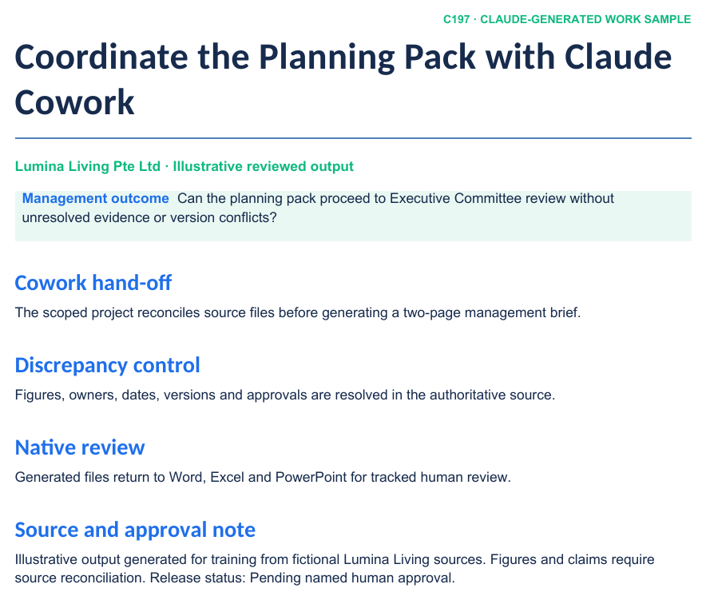
LAB 10 · SCREENSHOT
Claude-Generated Company Work Sample
WHAT TO NOTICE
1
Business outcome
The opening section states the management decision and intended use.
2
Evidence structure
Headings, tables and source notes make claims reviewable in native Word.
3
Approval boundary
The status and named reviewer remain visible before release or send.
A rendered preview of the realistic Word, Excel or PowerPoint artifact supplied in this lab folder.
Claude Microsoft 365 Masterclass (C197) · C197
© 2026 Tertiary Infotech Academy Pte Ltd
85

Slide 87
CONCEPT-TO-OUTCOME
Lab 10 — Process Map
1
2
3
4
5
▶
▶
▶
▶
Scope the folder
Connect approved context
Plan the task
Watch and steer
Review files in Microsoft 365
Claude Microsoft 365 Masterclass (C197) · C197
© 2026 Tertiary Infotech Academy Pte Ltd
86

Slide 88
KEY DECISIONS & CONTROLS
Lab 10 — Professional Practice
Bounded workspace
Give Cowork one project folder or Project, not uncontrolled access to unrelated files.
Connector supplies context
Search approved SharePoint, OneDrive, Outlook and Teams evidence through delegated permissions.
1
2
Cowork executes over steps
It can inspect inputs, create real files, update the plan and surface checkpoints.
Office add-ins finish the work
Open generated Word, Excel and PowerPoint files in the native apps for tracked review and approval.
3
4
Claude Microsoft 365 Masterclass (C197) · C197
© 2026 Tertiary Infotech Academy Pte Ltd
87

Slide 89
LAB 10 · VERIFY
Coordinate the Planning Pack with Claude Cowork
✅ ACCEPTANCE CHECK
Cowork worked only inside the scoped project, produced a visible plan and discrepancy log, and every generated Office artifact was reviewed in its native app before the hand-off was approved.
INSPECT
RECONCILE
ENDORSE
Open the native artifact and challenge its sources, formulas, structure and versions.
Confirm every material figure or claim against the approved evidence location.
Record the named reviewer before accepting, saving, releasing or sending the work.
Claude Microsoft 365 Masterclass (C197) · C197
© 2026 Tertiary Infotech Academy Pte Ltd
88

Slide 90
TOPIC 04 · HANDS-ON
Automate Excel, Outlook and a Daily Brief with Claude Code
LAB 11
Build a safe, repeatable work process that refreshes a local Excel control workbook, searches approved planning mail and generates a source-linked daily brief without embedding secrets or auto-sending messages.
You'll build
A reviewed automation plan, local workbook-update script, connector-assisted Outlook search and generated daily brief with run log.
Tools: Claude Code, MCP, Microsoft 365 connector, Python, openpyxl, python-docx, run log, approval gates
Claude Microsoft 365 Masterclass (C197) · C197
© 2026 Tertiary Infotech Academy Pte Ltd
89

Slide 91
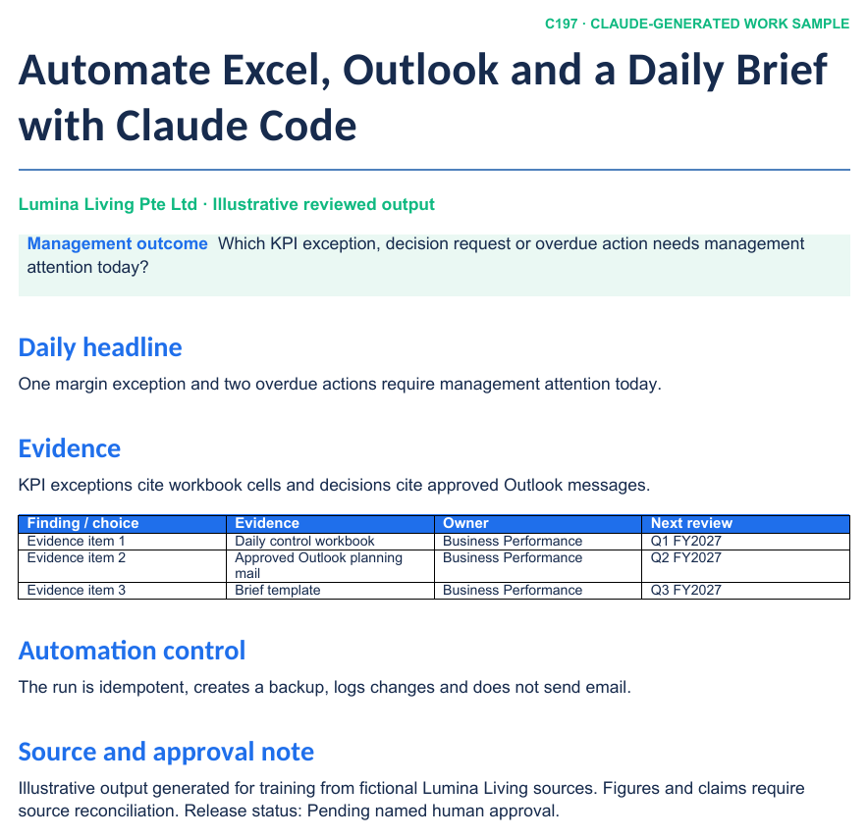
LAB 11 · SCREENSHOT
Claude-Generated Company Work Sample
WHAT TO NOTICE
1
Business outcome
The opening section states the management decision and intended use.
2
Evidence structure
Headings, tables and source notes make claims reviewable in native Word.
3
Approval boundary
The status and named reviewer remain visible before release or send.
A rendered preview of the realistic Word, Excel or PowerPoint artifact supplied in this lab folder.
Claude Microsoft 365 Masterclass (C197) · C197
© 2026 Tertiary Infotech Academy Pte Ltd
90

Slide 92
CONCEPT-TO-OUTCOME
Lab 11 — Process Map
1
2
3
4
5
▶
▶
▶
▶
Plan and inspect
Verify MCP and files
Update Excel locally
Search approved Outlook context
Generate and review daily brief
Claude Microsoft 365 Masterclass (C197) · C197
© 2026 Tertiary Infotech Academy Pte Ltd
91

Slide 93
KEY DECISIONS & CONTROLS
Lab 11 — Professional Practice
Connector inheritance
Claude.ai connectors can appear in Claude Code when signed in with the same Claude.ai subscription; verify with /mcp.
Local file automation
Use a small reviewed Python script to update workbook inputs and retain formulas, formats and audit entries.
1
2
Source-linked brief
Email findings cite the source message; KPI findings cite workbook cells or ranges.
No hidden side effects
The lab reads and drafts. Any external write or send action remains a separate explicit approval.
3
4
Claude Microsoft 365 Masterclass (C197) · C197
© 2026 Tertiary Infotech Academy Pte Ltd
92

Slide 94
LAB 11 · VERIFY
Automate Excel, Outlook and a Daily Brief with Claude Code
✅ ACCEPTANCE CHECK
The reviewed scripts run successfully, the updated workbook preserves formulas and charts, the daily brief cites Excel and Outlook evidence, the run log is complete and no email was sent or secret stored.
INSPECT
RECONCILE
ENDORSE
Open the native artifact and challenge its sources, formulas, structure and versions.
Confirm every material figure or claim against the approved evidence location.
Record the named reviewer before accepting, saving, releasing or sending the work.
Claude Microsoft 365 Masterclass (C197) · C197
© 2026 Tertiary Infotech Academy Pte Ltd
93

Slide 95
TOPIC RECAP
Recap — Agentic Coordination with Outlook, Cowork and Claude Code
Capability — Triage Outlook messages and prepare consistent replies with a human send gate.
Evidence retained — A triage queue, cited thread summary, approved reply templates, draft responses and an unsent meeting invitation.
1
2
Capability — Use Claude Cowork and Microsoft 365 context to coordinate a bounded multi-file company task.
Evidence retained — A Cowork project folder, execution plan, consolidated management brief, discrepancy log and reviewed Office hand-off.
3
4
Capability — Use Claude Code and approved connectors to update Excel, search Outlook and produce a daily management brief.
Evidence retained — A reviewed automation plan, local workbook-update script, connector-assisted Outlook search and generated daily brief with run log.
5
6
Claude Microsoft 365 Masterclass (C197) · C197
© 2026 Tertiary Infotech Academy Pte Ltd
94

Slide 96
WRAP-UP
Course Summary & Next Steps
Claude Microsoft 365 Masterclass (C197) · C197
© 2026 Tertiary Infotech Academy Pte Ltd
95

Slide 97
LEARNING OUTCOMES
What You Achieved
Choose the right Claude surface
Select the right Claude and Microsoft 365 operating surface for a governed company task.
Connect governed context
Connect approved Microsoft 365 context and map permissions, sources and evidence boundaries.
1
2
Prompt with an audit trail
Direct Claude with an auditable prompt contract and a human approval gate.
Plan marketing
Produce a decision-ready marketing plan in Word from approved company evidence.
3
4
Shape strategy
Develop an aligned strategic plan with choices, initiatives, owners, measures and risks.
Draft sustainability and HR content
Draft a sustainability report section and HR policy using source, legal and management review controls.
5
6
Claude Microsoft 365 Masterclass (C197) · C197
© 2026 Tertiary Infotech Academy Pte Ltd
96

Slide 98
LEARNING OUTCOMES
What You Achieved (cont.)
Analyse finance in Excel
Build a formula-driven financial analysis and executive dashboard in Excel.
Tell the story in PowerPoint
Create a highly visual strategic and marketing PowerPoint with native Excel charts and evidence traceability.
7
8
Coordinate Outlook safely
Triage Outlook messages and prepare approval-based replies without bypassing the human send gate.
Orchestrate with Claude Cowork
Use Claude Cowork with Microsoft 365 context to coordinate a multi-file planning workflow.
9
10
Automate with Claude Code
Use Claude Code and approved connectors to update Excel, search Outlook and produce a daily management brief.
11
Claude Microsoft 365 Masterclass (C197) · C197
© 2026 Tertiary Infotech Academy Pte Ltd
97

Slide 99
WRAP-UP
Keep Practising After the Course
Re-run the labs on your own machine — repetition is what makes the skills stick.
Apply the techniques to a real process or project in your own organisation.
1
2
Your course material stays available at https://lms-tms.tertiaryinfotech.com/.
Explore the follow-on courses at www.tertiarycourses.com.sg.
3
4
Claude Microsoft 365 Masterclass (C197) · C197
© 2026 Tertiary Infotech Academy Pte Ltd
98

Slide 100
CURRENT PRODUCT GUIDANCE
Selected References & Further Learning
Claude for Microsoft 365 overview
claude.com
Set up the Microsoft 365 connector
support.claude.com
1
2
Use Claude for Microsoft 365 with third-party platforms
claude.com
Get started in Claude Cowork in three steps
claude.com
3
4
Connect Claude Code to tools via MCP
code.claude.com
Copilot Cowork overview
learn.microsoft.com
5
6
Claude Microsoft 365 Masterclass (C197) · C197
© 2026 Tertiary Infotech Academy Pte Ltd
99

Slide 101
COURSE CLOSE
Thank You — Keep the Workflow Governed
Carry one connected evidence chain from source to decision.
1
2
3
BUILD
VERIFY
APPROVE
Create useful native Word, Excel and PowerPoint work products.
Trace claims, formulas, charts, recipients and assumptions to evidence.
Keep final save, release and send decisions with the authorised human.
Claude Microsoft 365 Masterclass (C197) · C197
© 2026 Tertiary Infotech Academy Pte Ltd
100

